Slide 1

Notes:
Cover Slide

Slide 2


Introduction
SIMPLE INTEREST
AND
COMPOUND INTEREST
Notes:
This is the template for slides with an image and a bullet list

Slide 3
Introduction
Principal (P): The original sum of money loaned/deposited. Also known as capital.
Interest (I): The amount of money that you pay to borrow money or the amount of money that you earn on a deposit.
Time (T): The duration for which the money is borrowed/deposited.
Rate of Interest (R): The percent of interest that you pay for money borrowed, or earn for money deposited
Notes:
This is the template for slides with an image and a bullet list

Slide 4
Introduction
Simple interest is when the interest on a loan or investment is calculated only on
the amount initially invested or loaned.
Simple interest is calculated by multiplying the daily interest rate by the principal,
by the number of days that elapse between payments.
Simple interest benefits consumers who pay their loans on time or early each
month.
Auto loans and short-term personal loans are usually simple interest loans.
Notes:
This is the template for slides with an image and a bullet list

Slide 5
Introduction
Compound interest is the interest calculated on the principal and the interest accumulated over the previous period.
It is unlike simple interest where interest is not added to the principal while calculating the interest during the next period.
Some of its applications are:
Increase or decrease in population.
The growth of bacteria.
Rise or depreciation in the value of an item.
Notes:
This is the template for slides with an image and a bullet list

Slide 6
Simple Interest Formula:
:
Simple Interest (SI) = {Principal (P) × Rate (R) × Time (T)}/100
Amount (A) = Principal (P) + Interest (I)
= P+[(PNT)/100]
=P{1+(NT/100)}
Principal (P) = Amount (A) – Interest (I) Interest (I) = Amount (A) – Principal (P)
Notes:
This is the template for slides with an image and a bullet list

Slide 7

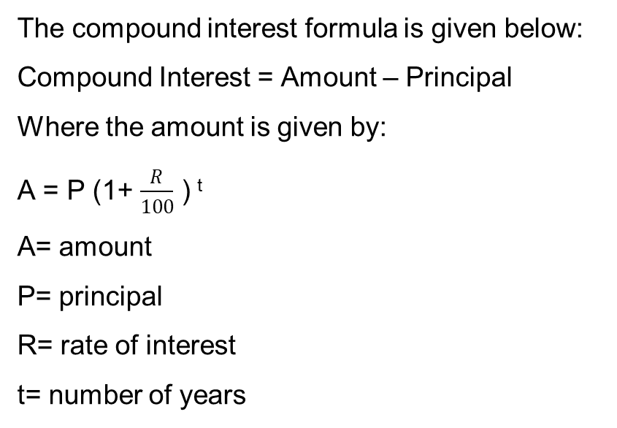
Compound Interest Formula:
:
The compound interest formula is given below:
Compound Interest = Amount – Principal
Where the amount is given by:
A = P (1+ $\frac{R}{100}$ ) ^{t}
A= amount
P= principal
R= rate of interest
t= number of years
CI =A-P
= P (1+ $\frac{R}{100}$ ) ^{t} - P
= P [(1+ $\frac{R}{100}$ ) ^{t} - 1]
Notes:
This is the template for slides with an image and a bullet list

Slide 8
Question 01:
Find the simple interest on Rs. 68,000 at 16(2/3)% per annum for a period of 9 months?
A) Rs. 8500
B) Rs. 3200
C) Rs. 2100
D) Rs. 4300
E) None of these
Answer: C
Notes:
Here, P = Rs. 68000, R = 50/3% per annum and T = 9/12 years = 3/4 years. Note that the time has been converted into years as the rate is per annum. The units of rate R and the time T have to be consistent. Now using the formula for the simple interest, we have:
S.I. = [{P×R×T}/100]; therefore we may write: S.I. = Rs. [68000×(50/3)×(3/4)×(1/100)] = Rs. 8500

Slide 9
Explanation:
Here, P = Rs. 68000, R = 50/3% per annum and T = 9/12 years = 3/4 years. Note that the time has been converted into years as the rate is per annum. The units of rate R and the time T have to be consistent. Now using the formula for the simple interest, we have:
S.I. = [{P×R×T}/100]; therefore we may write: S.I. = Rs. [68000×(50/3)×(3/4)×(1/100)] = Rs. 8500

Slide 10
Question 02:
A man took a loan from a bank at the rate of 12 % p.a. simple interest. After three years he had to pay Rs. 5400 interest only for the period. The principal amount borrowed by him was:
A) Rs. 12000
B) Rs. 11000
C) Rs. 15000
Answer: C
Notes:
Here we have, the principal = Rs. [{100×5400}/{12×3}] = Rs. 15000. Thus the correct option is C) Rs. 15000.

Slide 11
Explanation:
Here we have, the principal = Rs. [{100×5400}/{12×3}] = Rs. 15000. Thus the correct option is C) Rs. 15000.

Slide 12
Question 03:
Raymond bought a car for $40, 000. He took a $20,000 loan from a bank at an interest rate of 15% per year for a 3-year period. What is the total amount (interest and loan) that he would have to pay the bank at the end of 3 years?
A) Rs. 27,800
B) Rs. 24,500
C) Rs. 24,700
D) Rs. 22,300
Answer: A
Notes:
Simple Interest = 20,000 × 13% × 3 = 7,800
At the end of 3 years, he would have to pay
$20,000 + $7,800 = $27,800

Slide 13
Explanation:
Simple Interest = 20,000 × 13% × 3 = 7,800
At the end of 3 years, he would have to pay
$20,000 + $7,800 = $27,800

Slide 14
Question 04:
Find the simple interest on ₹ 68000 at 16 ²/₃ % p.a. for 9 months.
A) Rs.7500
B) Rs.8500
C) Rs.6500
D) Rs.5500
Answer: B
Notes:
Here, P = ₹68000
R = 16²/₃ % = 50/3% p.a.
T = 9 months = 9/12 years = ¾ years
SI = (68000 x 50/3 x ¾ x 1/100) = ₹8500

Slide 15
Explanation:
Here, P = ₹68000
R = 16²/₃ % = 50/3% p.a.
T = 9 months = 9/12 years = ¾ years
SI = (68000 x 50/3 x ¾ x 1/100) = ₹8500

Slide 16
Question 05:
Ariel takes a loan of $8,000 to buy a used truck at the rate of 9 % simple Interest. Calculate the annual interest to be paid for the loan amount.
A) Rs. 850
B) Rs. 720
C) Rs. 340
D) Rs. 510
E) None of these
Answer: B
Notes:
From the details given in the problem Principle = P = $8,000 and R = 9% or 0.09 expressed as a decimal. As the annual Interest is to be calculated, the time period T =1. Plugging these values in the simple Interest formula, I = P x T x R = 8,000 x 1 x 0.09 = 720.00 Annual Interest to be paid = $720

Slide 17
Explanation:
From the details given in the problem Principle = P = $8,000 and R = 9% or 0.09 expressed as a decimal. As the annual Interest is to be calculated, the time period T =1. Plugging these values in the simple Interest formula, I = P x T x R = 8,000 x 1 x 0.09 = 720.00 Annual Interest to be paid = $720

Slide 18
Question 06:
Ryan bought $ 15,000 from a bank to buy a car at 10% simple Interest. If he paid $ 9,000 as interest while clearing the loan, find the time for which the loan was given
A) 6 years
B) 8 years
C) 4 years
D) 7 years
E) None of these
Answer: A
Notes:
Principle = $ 15,000 Rate of Interest R = 10% = 0.10 and the Interest paid = I = $ 9,000. And T is to be found. T = I/(PR) = 9000/(15,000 x 0.10) = 6 years. The loan was given for 6 years.

Slide 19
Explanation:
Principle = $ 15,000 Rate of Interest R = 10% = 0.10 and the Interest paid = I = $ 9,000. And T is to be found. T = I/(PR) = 9000/(15,000 x 0.10) = 6 years. The loan was given for 6 years.

Slide 20
Question 07:
If Rs. 4 becomes Rs. 10 in 50 years at simple interest, the rate % p.a. is
A) 5 %
B) 2 1/2 %
C) 3 1/3 %
D) 3 %
E) 6 %
Answer: D
Notes:
Option D Explanation: SI = 10 – 4 = 6 therefore, 6 = (4xRx50)/100 → R = 3 %.

Slide 21
Explanation:
Option D Explanation: SI = 10 – 4 = 6 therefore, 6 = (4xRx50)/100 → R = 3 %.

Slide 22
Question 08:
Find out the capital required to earn a monthly interest of Rs. 210 at 7 % simple interest.
A) Rs. 24000
B) Rs. 36000
C) Rs. 18000
D) Rs. 30000
E) Rs. 72000
Answer: B
Notes:
Explanation: 210 = (Px7x1)/100x12 → P = 36000

Slide 23
Explanation:
Explanation: 210 = (Px7x1)/100x12 → P = 36000

Slide 24
Question 09:
A total of $1,200 is invested at a simple interest rate of 6% for 4 months. How much interest is earned on this investment?
A) 20
B) 72
C) 16
D) 24
E) None of these
Answer: D
Notes:
Before we can apply the formula, we will need to write the time of 4 months in terms of years. Since there are 12 months in a year:
t=412=13t=412=13
With this adjusted to years, we can now apply the formula with P=1200P=1200 and r=0.06r=0.06.
I=Prt=1200(0.06)(13)=24I=Prt=1200(0.06)(13)=24
Answer: The interest earned is $24.

Slide 25
Explanation:
Before we can apply the formula, we will need to write the time of 4 months in terms of years. Since there are 12 months in a year:
t=412=13t=412=13
With this adjusted to years, we can now apply the formula with P=1200P=1200 and r=0.06r=0.06.
I=Prt=1200(0.06)(13)=24I=Prt=1200(0.06)(13)=24
Answer: The interest earned is $24.

Slide 26
Question 10:
A business takes out a simple interest loan of $10,000 at a rate of 7.5%. What is the total amount the business will repay if the loan is for 8 years?
A) Rs. 48,000
B) Rs. 36,000
C) Rs. 16,000
D) Rs. 35,600
Answer: C
Notes:
he total amount they will repay is the future value, AA. We are also given that:
t=8t=8
r=0.075r=0.075
P=10000P=10000
Using the simple interest formula for future value:
A=P(1+rt)=10000(1+0.075(8))=16000A=P(1+rt)=10000(1+0.075(8))=16000
Answer: The business will pay back a total of $16,000.

Slide 27
Explanation:
he total amount they will repay is the future value, AA. We are also given that:
t=8t=8
r=0.075r=0.075
P=10000P=10000
Using the simple interest formula for future value:
A=P(1+rt)=10000(1+0.075(8))=16000A=P(1+rt)=10000(1+0.075(8))=16000
Answer: The business will pay back a total of $16,000.

Slide 28
Question 11:
A sum of money at simple interest amounts to Rs. 850 in 3 years and to Rs. 900 in 4years. The sum is:
A) Rs. 650 B) Rs. 690 C) Rs. 725 D) Rs. 700
Answer: D
Notes:
Answer : (d)
S.I. for 1 year = 900 – 850 = Rs 50
S.I. for 3 years = 50 x 3 = Rs 150
Original Amount/ Principal = 850 – 150 = Rs 700

Slide 29
Explanation:
Answer : (d)
S.I. for 1 year = 900 – 850 = Rs 50
S.I. for 3 years = 50 x 3 = Rs 150
Original Amount/ Principal = 850 – 150 = Rs 700

Slide 30
Question 12:
If the simple interest on Rs 500 increases by Rs 10 when time increases by 4 years. Find the rate per annum.
A) 0.5% B) 0.2% C) 0.3% D) 0.7%
Answer: A

Slide 31
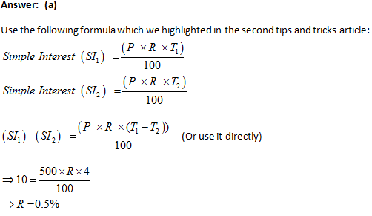
Explanation:

Slide 32
Question 13:
A sum of Rs. 15,000 amounts to Rs. 19,500 in 5 years at the rate of simple interest. What is the rate of interest?
A) 3% B) 4% C) 5% D) 6%
E) None of these
Answer: D
Notes:
Here P = Rs. 15000 and Amount = Rs. 19500
Hence S.I. = Rs. 19500–Rs. 15000 = Rs. 4500.
We know: Simple Interest (SI) = (P x R x T)/100
P – Principal amount, T- Number of years, R – Rate of Interest
Therefore, 4500 = (15000xRx5)/100
R = 6%

Slide 33
Explanation:
Here P = Rs. 15000 and Amount = Rs. 19500
Hence S.I. = Rs. 19500–Rs. 15000 = Rs. 4500.
We know: Simple Interest (SI) = (P x R x T)/100
P – Principal amount, T- Number of years, R – Rate of Interest
Therefore, 4500 = (15000xRx5)/100
R = 6%

Slide 34
Question 14:
A sum fetched a total simple interest of Rs. 4016.25 at the rate of 9% p.a. in 5 years. What is the sum?
A) Rs. 4462.50 B) Rs. 8032.50 C) Rs. 8900 D) Rs. 8925
Answer: D

Slide 35
Explanation:
Principal= (100 x 4016.25)/(9 x 5)= Rs.401625/45= Rs. 8925

Slide 36
Question 15:
A man invests ₹ 5000 for 3 years at 5% p.a. compounded interest reckoned yearly. Income tax at the rate of 20% on the interest earned is deducted at the end of each year. Find the amount at the end of third year.
A) Rs. 4800
B) Rs. 3600
C) Rs. 5624
D) Rs. 4530
Answer: C
Notes:
Here, P = ₹5000, T = 3 years, r = 5%
Therefore, Interest at the end of 1st year = 5000 (1 + 0.05) – 5000 = ₹250
Now Income tax is 20% on the interest income so the leftover interest income after deducing income tax = (1 – 0.2) * 250 = ₹200
Total Amount at the end of 1st year = ₹5000 + 200 = ₹5200
Interest at the end of 2nd year = 5200 (1 + 0.05) – 5200 = ₹260
Interest income after Income tax = 0.8 * ₹260 = ₹208
Total Amount at the end of 2nd year = ₹5200 + 208 = ₹5408
Interest at the end of 3rd year = ₹5408 (1.05) – 5408 = ₹270.4
Interest income after Income tax = 0.8 * ₹270.4 = ₹216.32
Total Amount at the end of 3rd year = ₹5408 + 216.32 = ₹5624.32

Slide 37
Explanation:
Here, P = ₹5000, T = 3 years, r = 5%
Therefore, Interest at the end of 1st year = 5000 (1 + 0.05) – 5000 = ₹250
Now Income tax is 20% on the interest income so the leftover interest income after deducing income tax = (1 – 0.2) * 250 = ₹200
Total Amount at the end of 1st year = ₹5000 + 200 = ₹5200
Interest at the end of 2nd year = 5200 (1 + 0.05) – 5200 = ₹260
Interest income after Income tax = 0.8 * ₹260 = ₹208
Total Amount at the end of 2nd year = ₹5200 + 208 = ₹5408
Interest at the end of 3rd year = ₹5408 (1.05) – 5408 = ₹270.4
Interest income after Income tax = 0.8 * ₹270.4 = ₹216.32
Total Amount at the end of 3rd year = ₹5408 + 216.32 = ₹5624.32

Slide 38
Explanation:
Simple interest on a certain sum of money for 3 years at 8% per annum is half the compound interest on Rs. 4000 for 2 years at 10% per annum. The sum placed on simple interest is:

Slide 39
Explanation:
If the simple interest on a sum of money for 2 years at 5% per annum is Rs. 50, what is the compound interest on the same at the same rate and for the same time?

Slide 40
Explanation:

